Slide 1
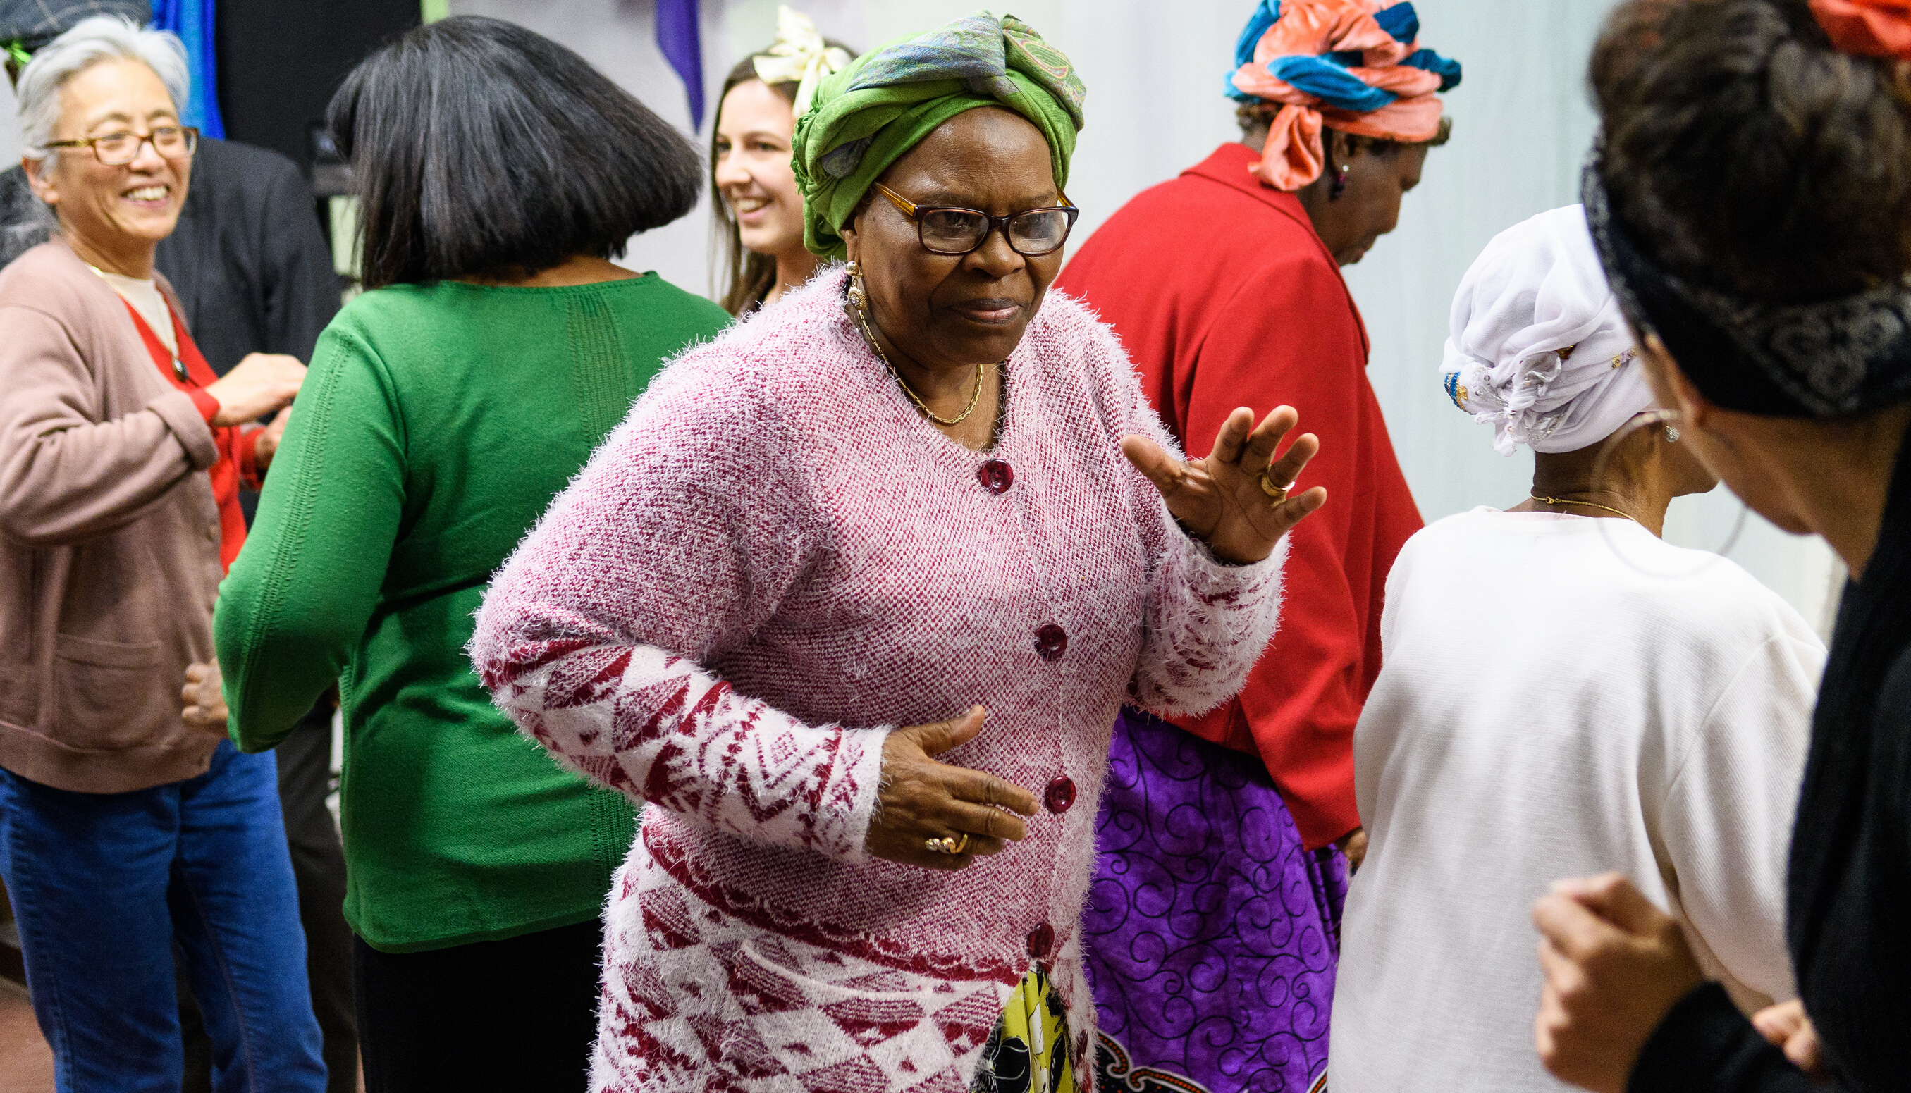
Creative Festivals May 2020

Slide 2
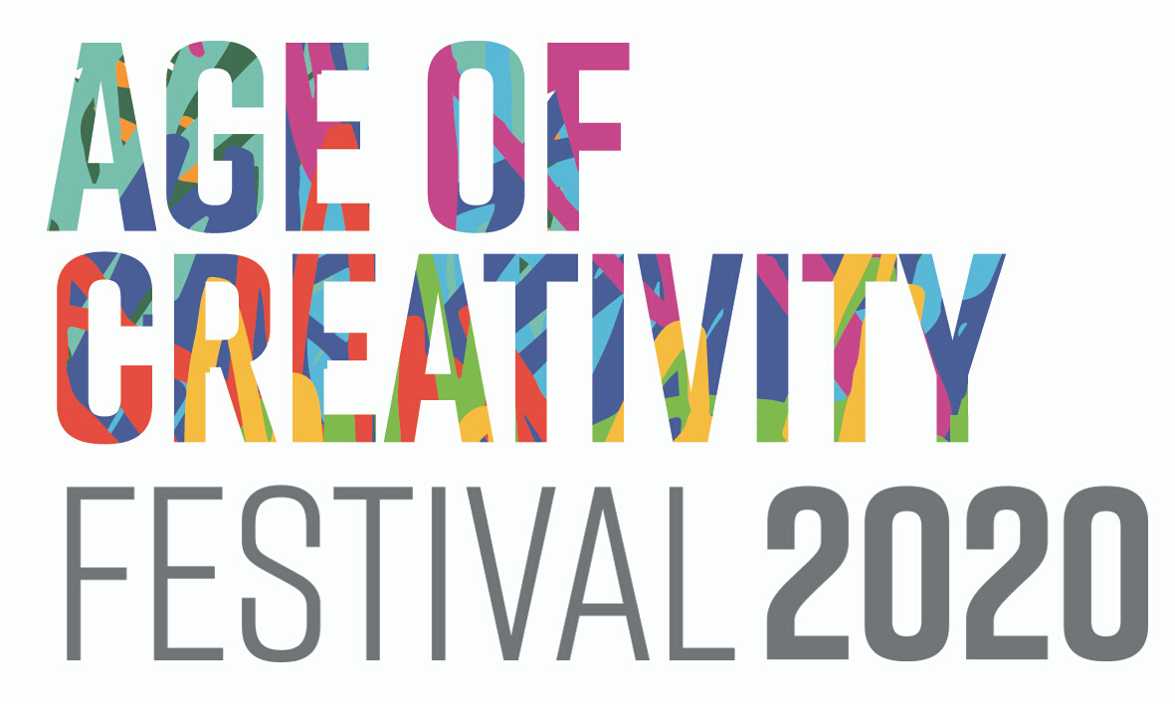
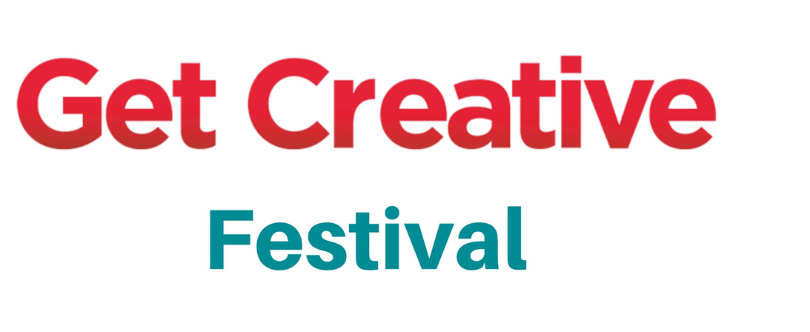
MAY IS CREATIVITY MONTH!
The Collaborative partnership of Creative Festivals aims to turn May 2020 into a month of creativity and culture with three festivals working closely together.

Slide 3
CREATIVE FESTIVALS MAY 2020
We are working together so that we can make more of a noise about creativity as a collective voice
We recognised an overlap and common aims and decided to work together
We are running a series of events across the country, like this one, as a collective. Which wouldn't be possible if we weren't working together
We are sharing certain resources but each festival will keep it's identity
You can choose to take part in one, two or all three festivals but you will need to register for each separately

Slide 4
"THIS STUDY IS THE FIRST TO SHOW THE COGNITIVE STRATEGIES THE BRAIN USES TO REGULATE OUR EMOTIONS WHEN WE’RE TAKING PART IN CREATIVE ACTIVITIES. WHILE PREVIOUS STUDIES HAVE SHOWN THE STRONG LINK BETWEEN CREATIVE ACTIVITIES AND EMOTIONS, WE'VE NOT BEEN SURE ABOUT HOW THIS HAS BEEN HAPPENING."
DR DAISY FANCOURT, MAY 2019

Slide 5
9-17 MAY
18-24 MAY
1-31 MAY
CREATIVE OR CULTURAL EVENTS
AGE FRIENDLY
FREE OR LOW FEE
CREATIVE, PARTICIPATORY EVENTS
OPEN TO ANYONE
FREE OR COST-RECOVERY
CREATIVE OR CULTURAL EVENTS
CONNECTION TO HEALTH & WELLBEING
FREE OR LOW FEE

Slide 6
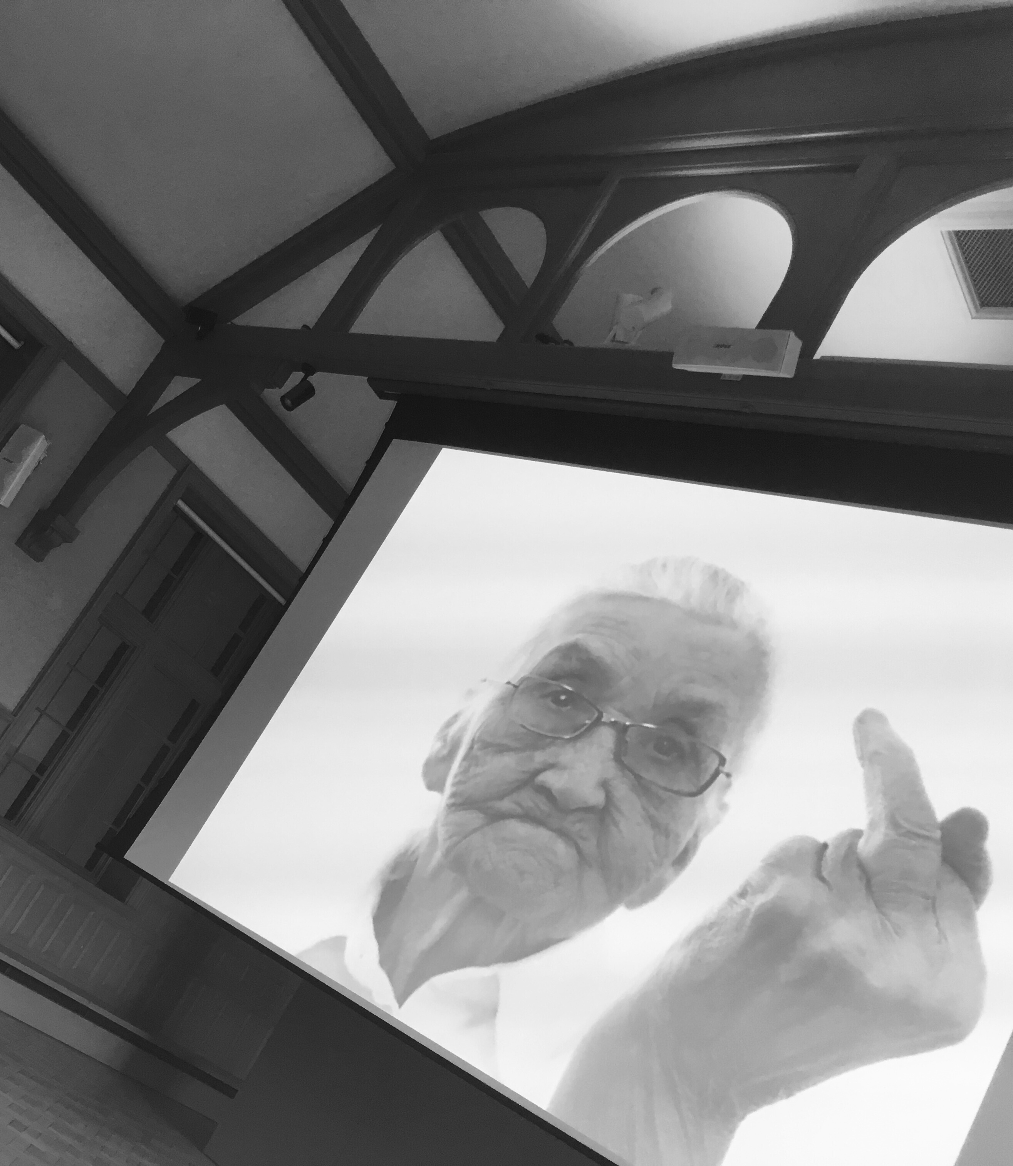
REACHING OUT
Our theme for 2020/21 will focus efforts on connecting with individuals and communities that experience the most significant barriers to creative engagement, with a particular focus on more representation of: Disability, BAME and LGBTQ+.

Slide 7
National headline events and training for professionals
National printed programme of local cultural events for older people
National programme of online events and support tools
Artistic commissions and focus on older artists
National Campaign including ‘Ageing Provocateurs’ ageism strand.

Slide 8
"It's new for me and very fulfilling. We have an excellant teacher and its very good to be doing something new in the monotony of a care home."
Age of Creativity Participant, May 2019

Slide 9
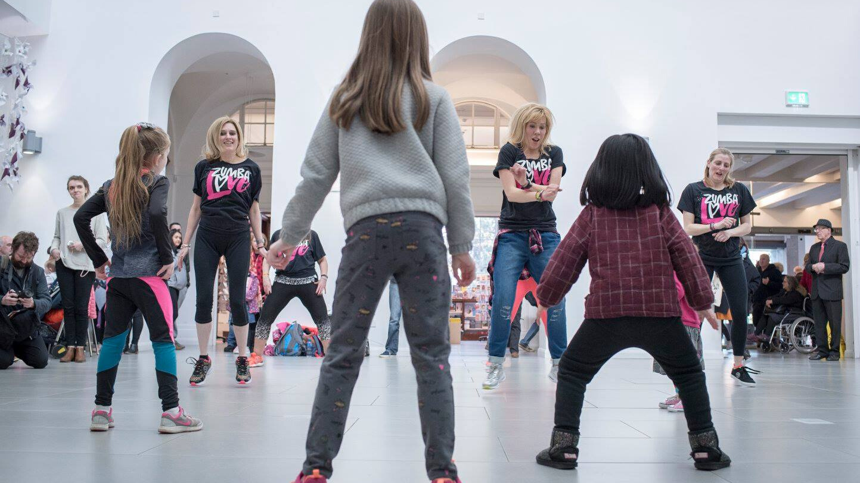
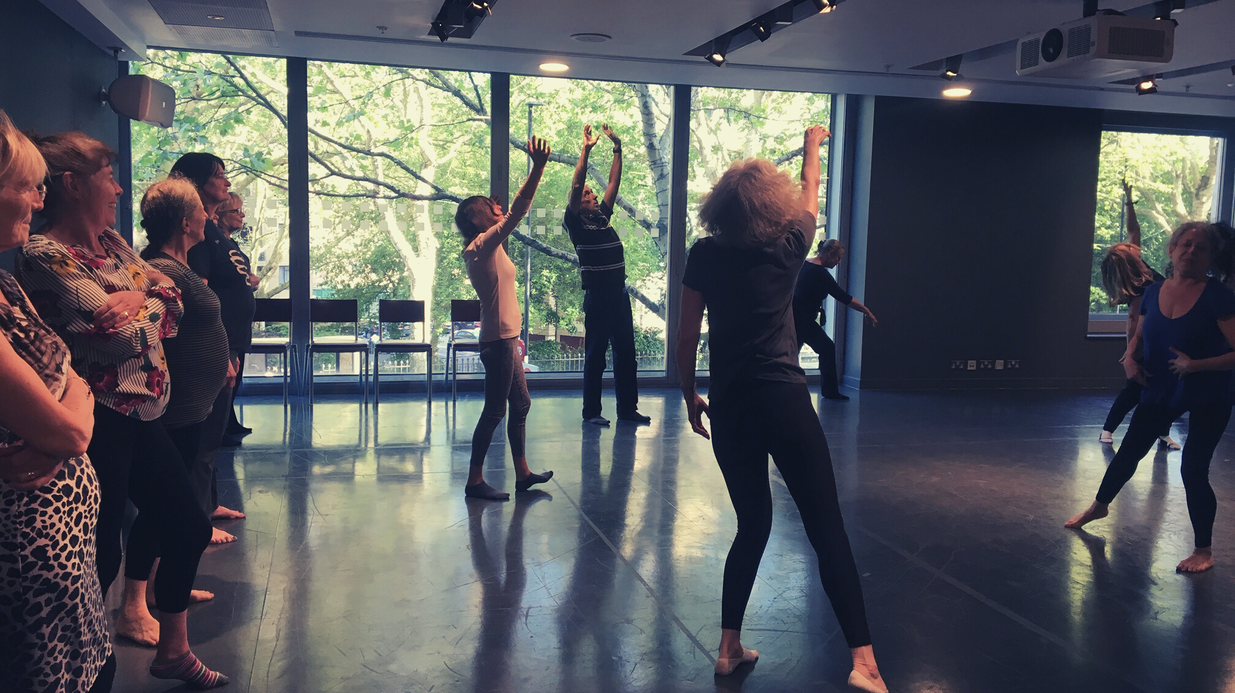
CREATIVITY AND INCLUSIVITY
THERE IS A THEME THIS YEAR FOR
OUR WORK IN ENGLAND, FOCUSING ON DANCE EVENTS, INCLUSIVITY AND
OPPORTUNITIES FOR DISABLED PEOPLE TO PARTICIPATE

Slide 10
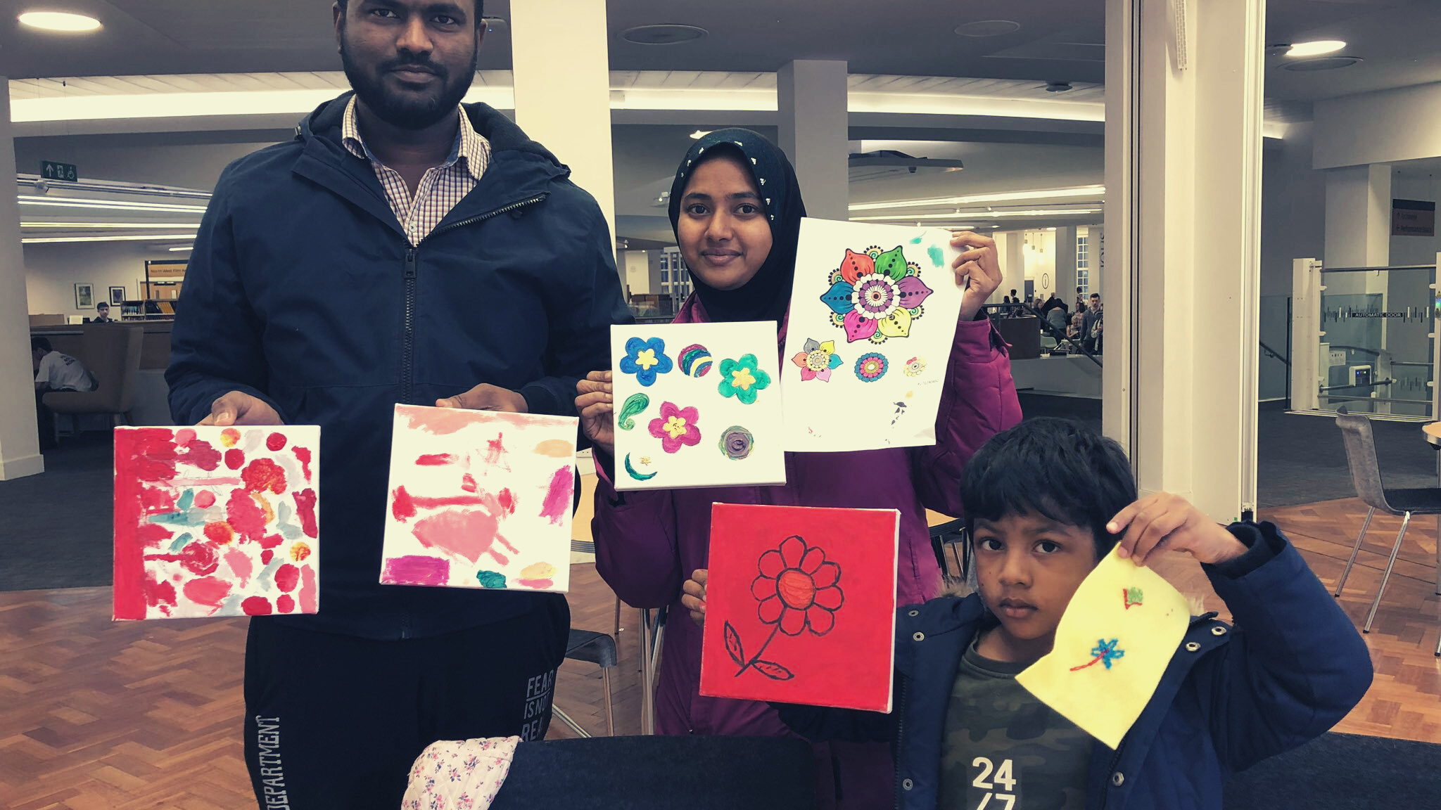
GET CREATIVE FESTIVAL IS THE UK’S BIGGEST CELEBRATION OF CREATIVITY AND CONTINUES TO GROW EACH YEAR.
THE FESTIVAL DOES NOT PROGRAMME EVENTS BUT ACTS AS A MAJOR NATIONAL PLATFORM FOR CREATIVE EVENTS.
‘GET CREATIVE’ FESTIVAL IS AN OPPORTUNITY TO SHINE A SPOTLIGHT ON EXISTING GROUPS AND ACTIVITIES.
GETTING CREATIVE IS BENEFICIAL TO THE WELLBEING OF ALL PEOPLE, REGARDLESS OF AGE OR BACKGROUND

Slide 11
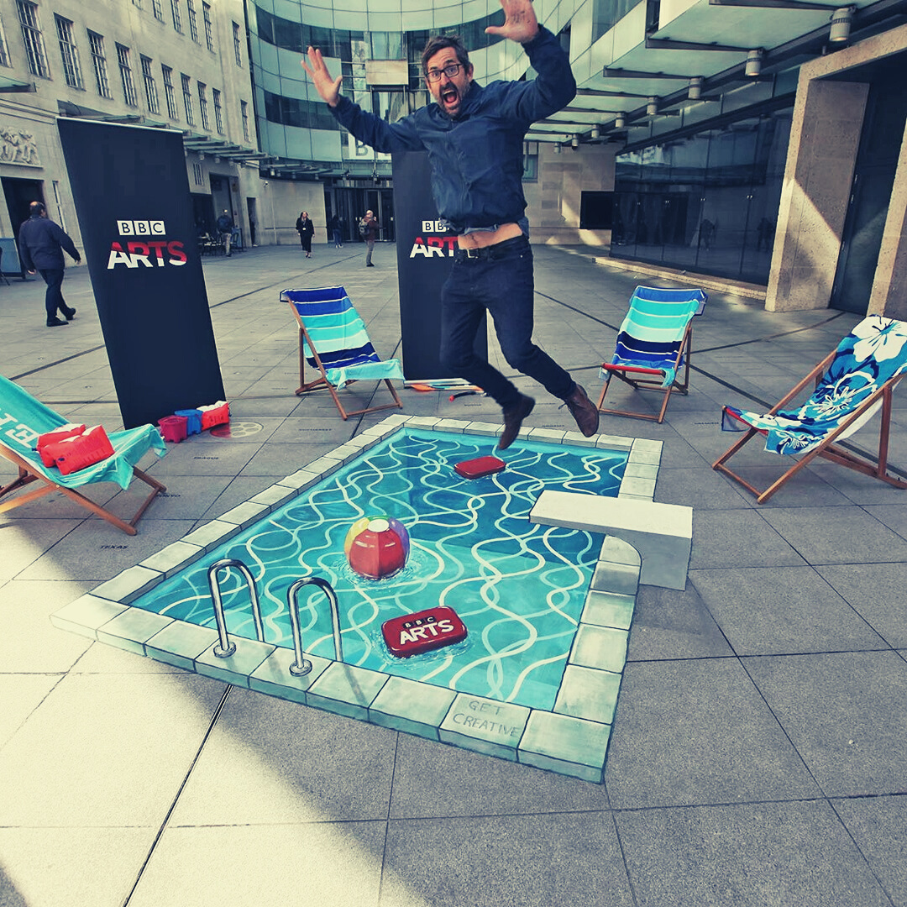
"I THINK BEING CREATIVE IS PART OF THE HUMAN CONDITION. IF YOU STIFLE CREATIVITY THEN YOU'RE REALLY ONLY LEADING HALF A LIFE. I THINK THERE'S NOTHING ELSE THAT QUITE COMPARES WITH IT."
LOUIS THEROUX, MAY 2019

Slide 12
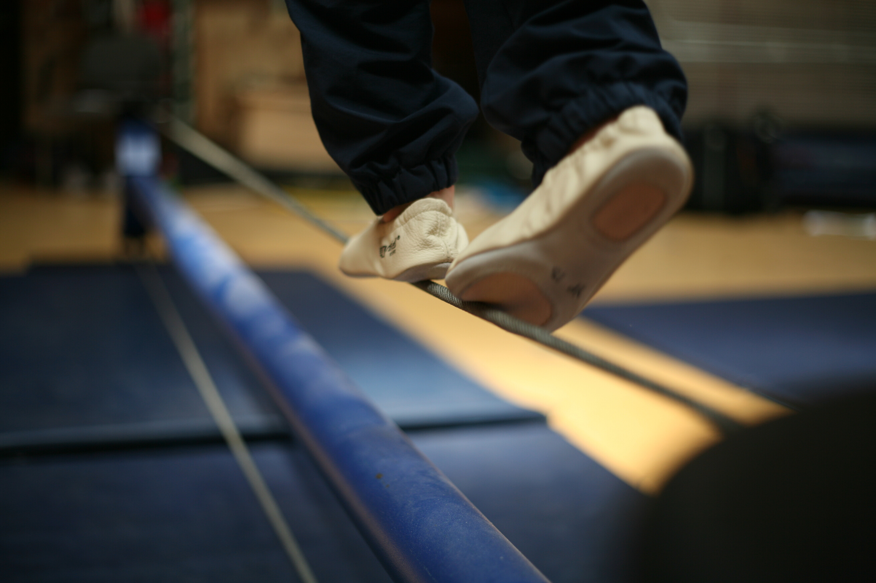
POSITIVE FUTURES
THE FESTIVAL FOCUS THIS YEAR WILL BE ON MENTAL HEALTH, CLIMATE CHANGE AND LOOKING TO THE FUTURE. WE ARE IN TURBULANT TIMES WITH HEALTH AND WELLBEING SUFFERING. BUT WHAT CAN ENGAGING IN CULTURE AND CREATIVITY DO TO IMPROVE LIVES? HOW CAN THE ARTS MAKE SENSE OF IT ALL?

Slide 13
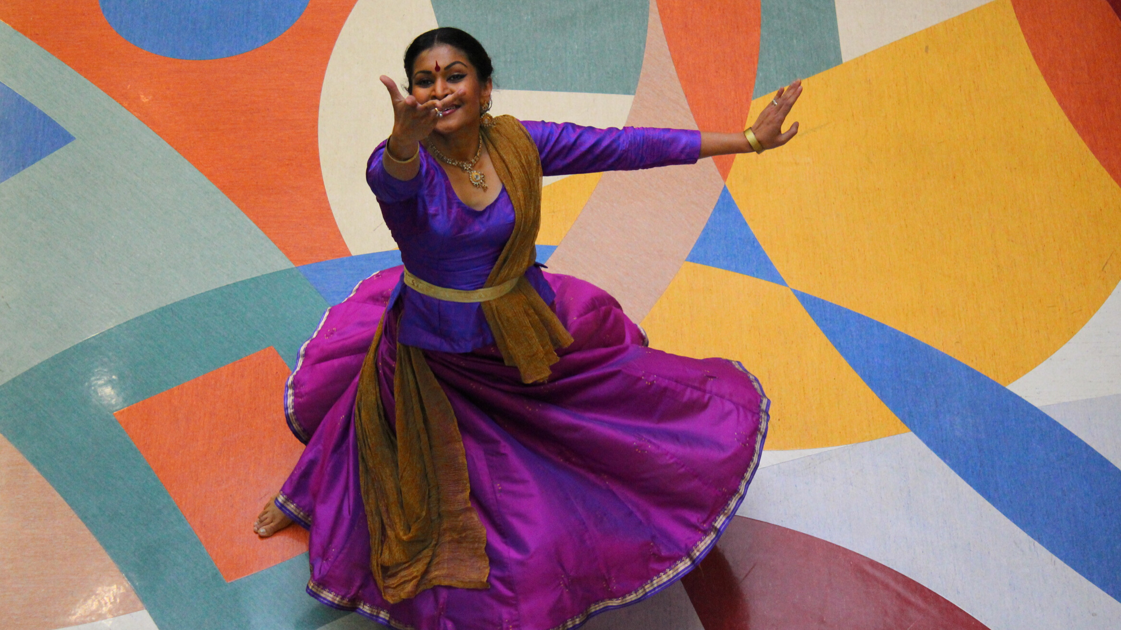
The Festival is being run by London Arts and Health and the Culture, Health and Wellbeing Alliance.
The events can be anywhere in the UK and take place in any setting.
You could be highlighting a current project or trying out a new group.
The festival is all about celebrating creativity and wellbeing but also events which support, inform and showcase the sector.
The programme is a mixture of core events organised by the festival, and events hosted by by other organisations.

Slide 14
“Being involved in Creativity & Wellbeing Week has been a great opportunity for us to be involved in a city-wide festival that celebrates the impact that the arts can have on our health. It’s allowed us to reach further audiences & showcase the diversity in projects that we run.
Daniel Regan, Artistic Director, Free Space Project

Slide 15
Festival website is LIVE. It is accessible to older people and you can upload your events
Regional brochures will be produced and distributed through 150 local Age UKs across England
Deadline for brochure is 1 March
You can upload events to the website which has an interactive map.
Events must be participatory
Deadline for uploading events 2 May
You will be able to upload events directly to our website launched soon
No printed brochure this year
Events must have a strong focus on health and wellbeing
Deadline for uploading Events 11 May

Slide 16
KEY EVENTS
We are working together as a collective to host an event on publichealth and everyday creativity.
This will be hosted in York on 15 May, tentatively
titled 'Does Creativity Need a Public Health
Campaign?'
1he Age of Creativity festival launch event is ‘What’s my age again?’
at The Whitworth Art Gallery in Manchester on 7 May
On 18 May Creativity and Wellbeing Week will be kicking off with a launch event 'Creating Positive Futures' at the National Portrait Gallery. Exploring the themes of the week.

Slide 17
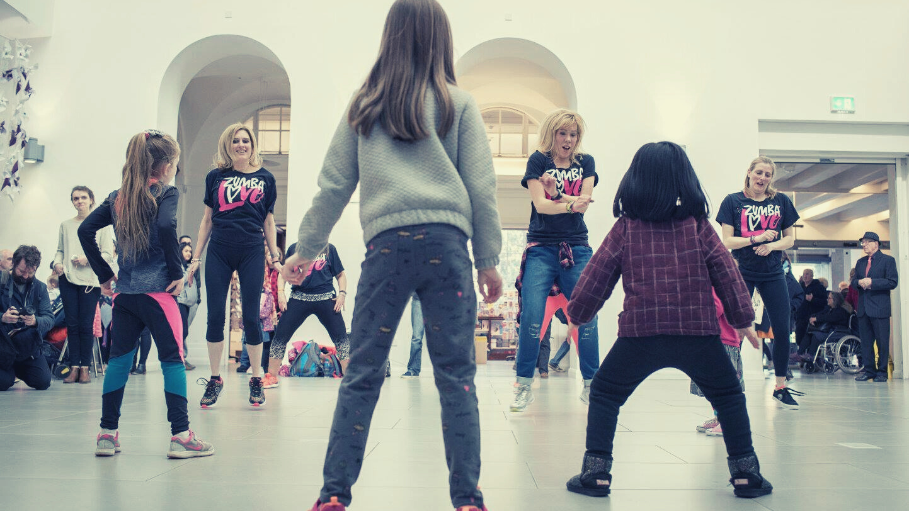
WE WANT TO MAKE A NOISE!
THE EARLIER YOU ARE ABLE TO UPLOAD YOUR EVENT THE MORE CHANCE WE HAVE TO MARKET YOUR EVENT.
WE WILL BE OFFERING ADVICE ON GETTING MEDIA COVERAGE FOR YOUR EVENTS BUT WE ALSO GET REQUESTS FOR CASE STUDIES SO GET IN THERE EARLY!
IF YOU OR YOUR EVENT HAS AN INTERESTING OR NEWSWORTHY ANGLE FOR YOUR CHOSEN FESTIVAL THEN GET IN TOUCH.
IF YOU HAVE ANY PRESS CONTACTS LET YOUR FESTIVAL TEAM KNOW.
SUPPORT OTHER EVENTS AS MUCH AS POSSIBLE BY SHARING ON SOCIAL MEDIA AND ATTENDING WHERE POSSIBLE.

Slide 18
WWW.CREATIVITYANDWELLBEING.ORG.UK
STILL A WORK IN PROGRESS!

Slide 19
WEBSITES
WWW.AGEOFCREATIVITY.CO.UK
WWW.GETCREATIVEUK.COM
CREATIVITYANDWELLBEING.ORG.UK

